Slide 1

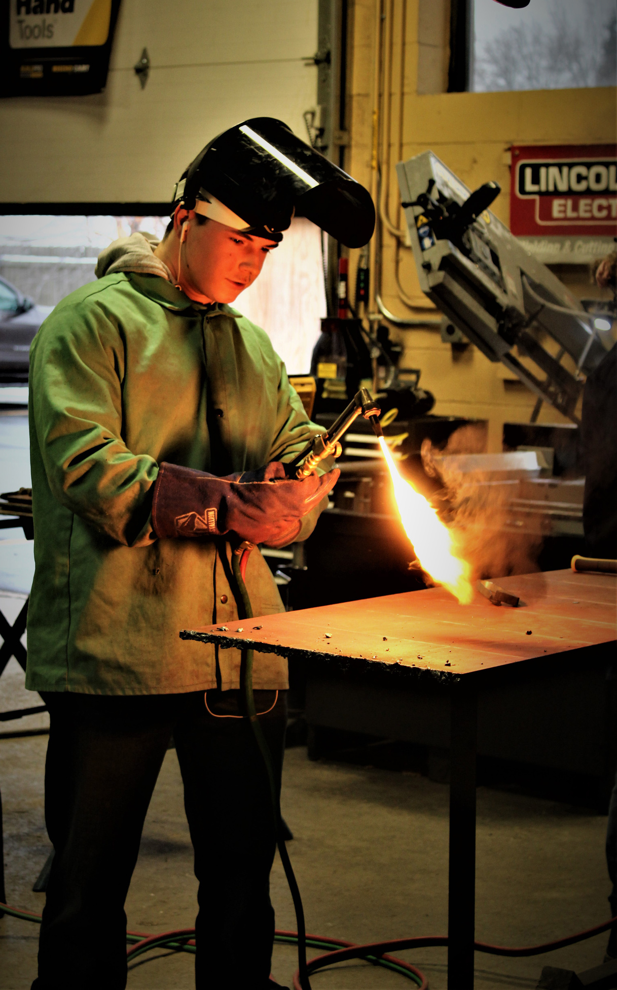
Welcome to
FAMILY
ORIENTATION

Slide 2
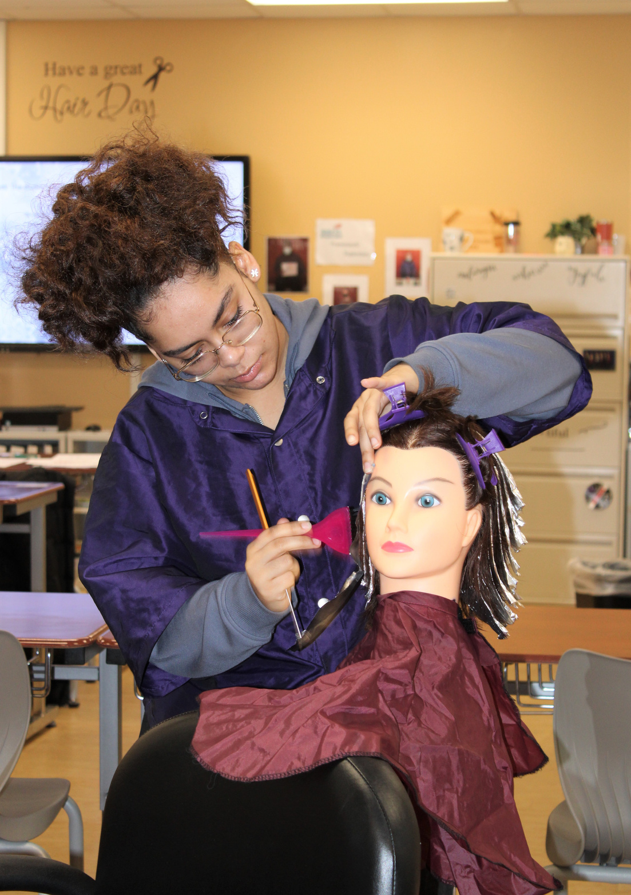
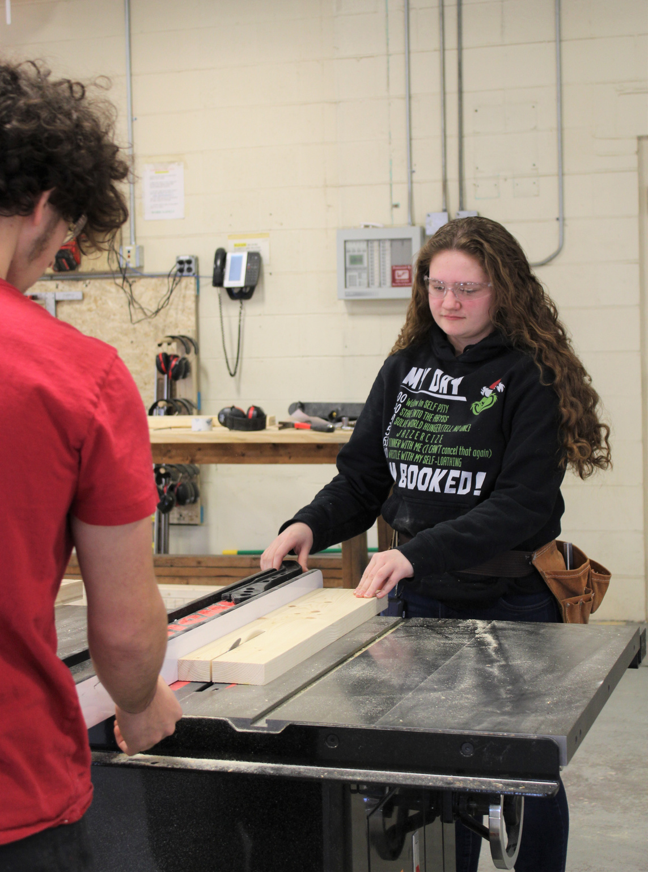
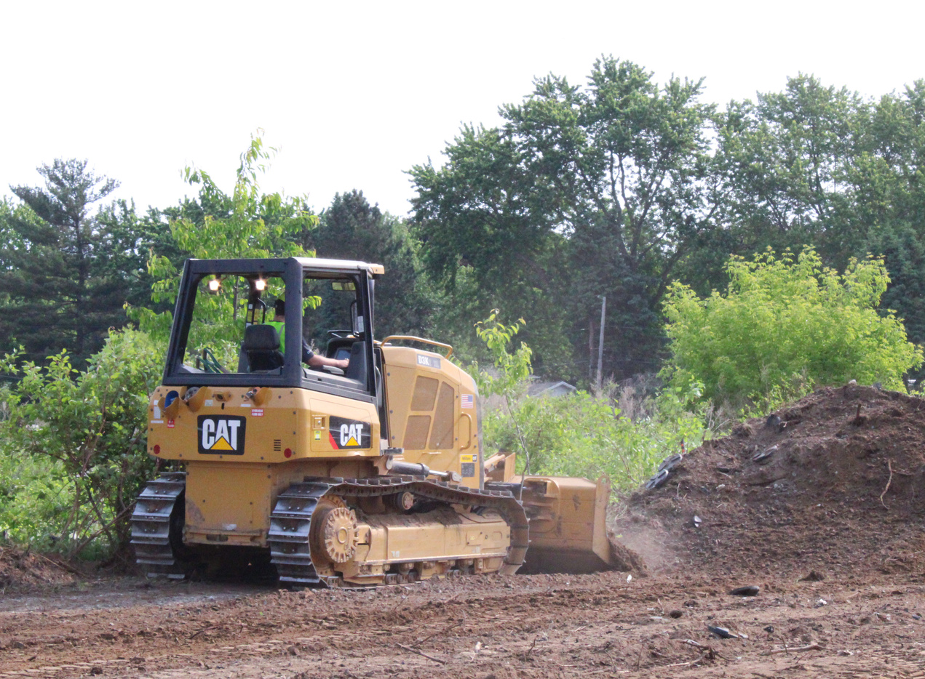



CTE KNOWLEDGE & SKILLS
  Technical
  Academic
  Career Readiness

Slide 3
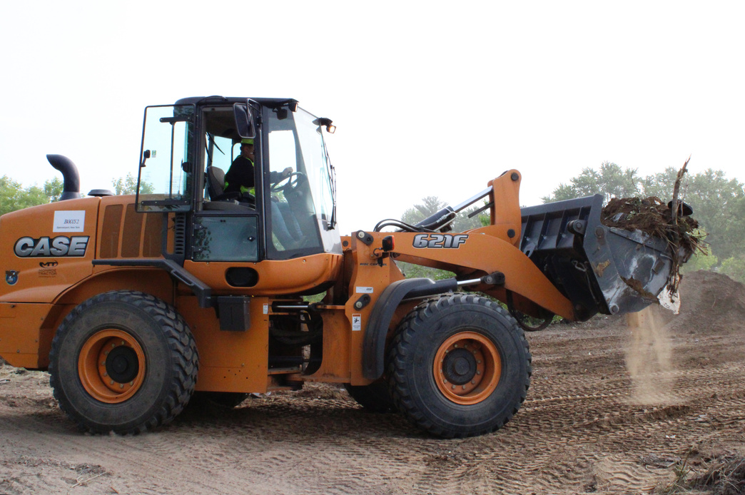
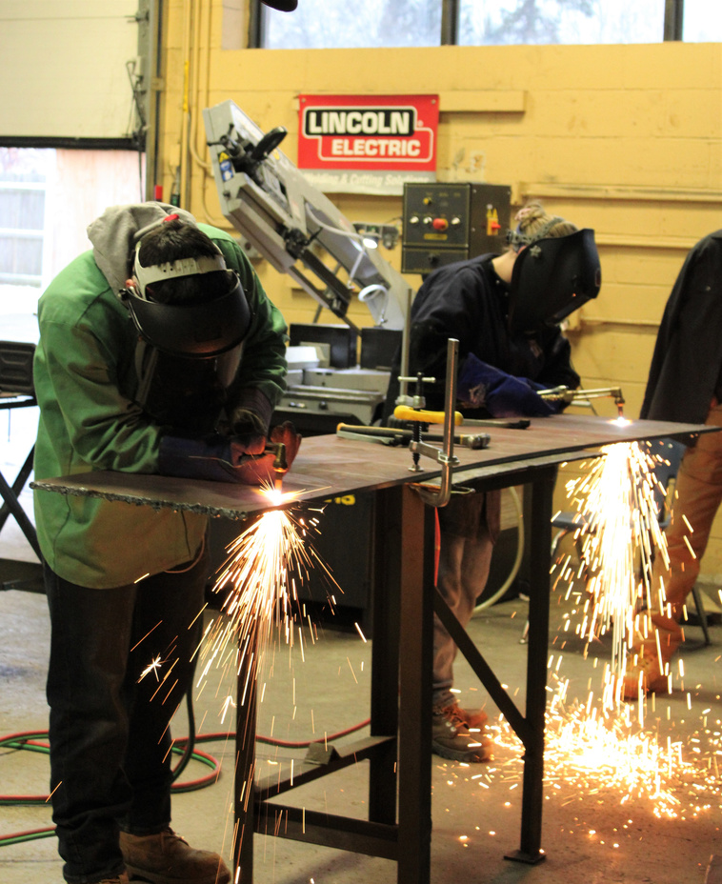
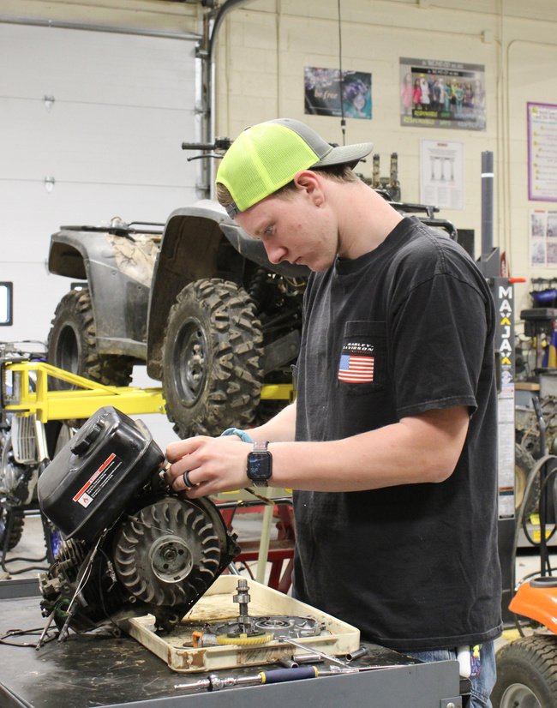
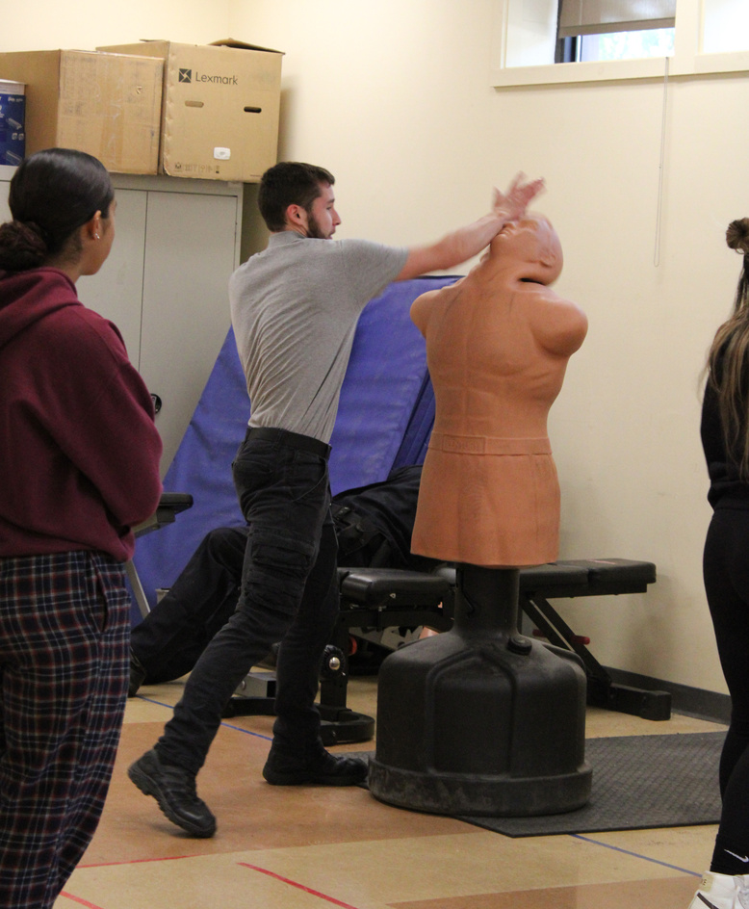
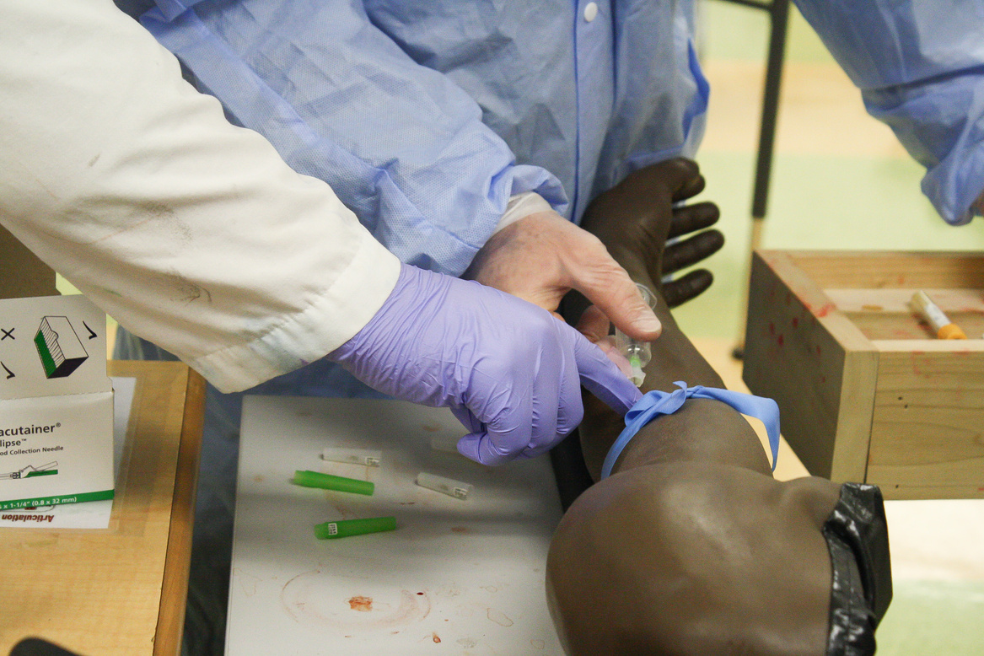
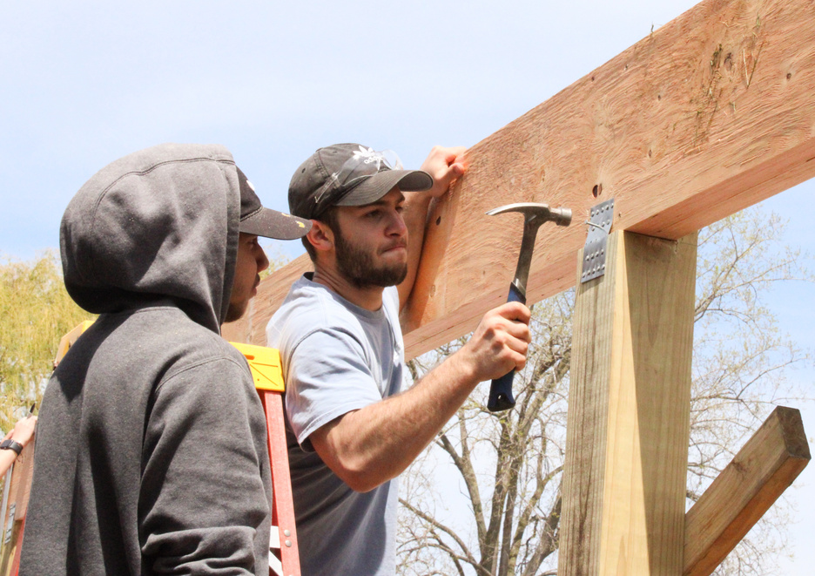
BUILDING EXPECTATIONS
Safety first means...
Being under the influence of any substance is dangerous when working with equipment, chemicals and other supplies
On arrival, students report directly to their program
Distractions of electronic devices, horseplay, etc...
Students are expected to wear appropriate personal protective equipment (PPE) and/or uniform for their industry
Cybersafety
Equipment, Chemicals, and other supplies in our programs are dangerous if/when used inappropriately
Transportation
Weapons/look alike weapons

Slide 4
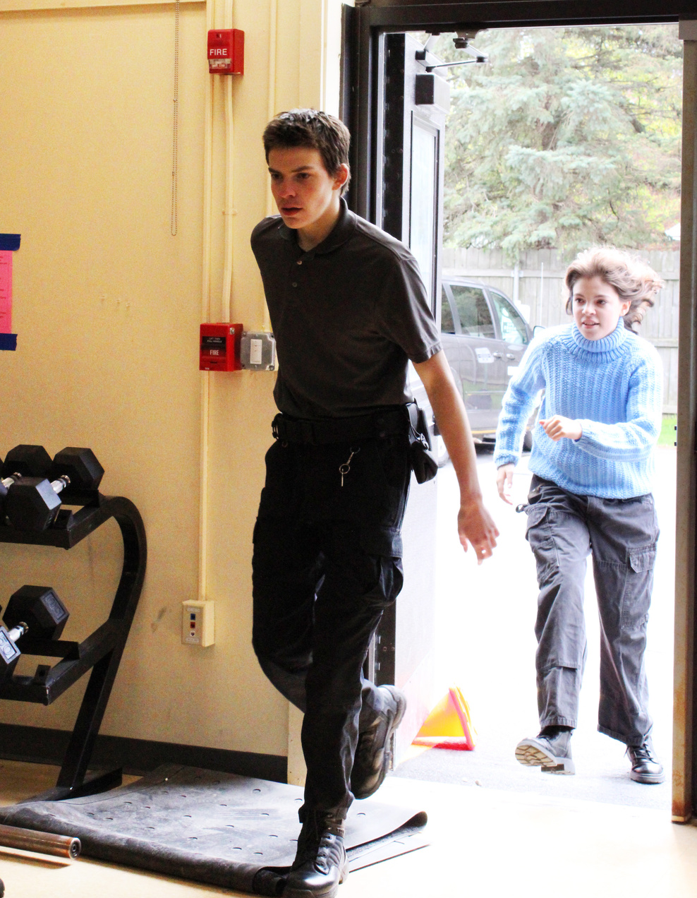
STUDENT ATTENDANCE
Attendance is critical to a student's success
It is difficult to make up performance activities and assessments
Parents must call/email attendance offices at the BOTH home school and WEMOCO
Email: CTEattendance@monroe2boces.org
Phone:
(585) 352-2477

Slide 5
CTE SCHEDULE
A.M. Session
Seniors
P.M. Session
Juniors
7:50 a.m.
10:15 a.m.
12:00 p.m.
2:25 p.m.

Slide 6
Theory
Lab
50% of a student's grade
50% of a student's grade
  Knowledge Activities
  Knowledge Assessments
  Performance Activities
  Performance Assessments
GRADING
  Some programs have clinicals embedded. These are NOT optional and students work with live patients/clients (Dental Assisting, Nurse Assisting, Cosmetology)
  All programs have integrated academics (literacy, math and/or science)
  Students receive 1/2 credit (54 hours) of Career and Financial Management in every program
  All programs have "live work" for customers
CTE Parent Portal : https://monroe2boces.az1.qualtrics.com/jfe/form/SV_1NOYjsjJAEtbf7f

Slide 7

TECHNICAL ENDORSEMENT
Seal of honor placed on students high school diploma if...
  Pass both written and performance portion of their technical assessment
  Pass all requirements of student portfolio

Slide 8


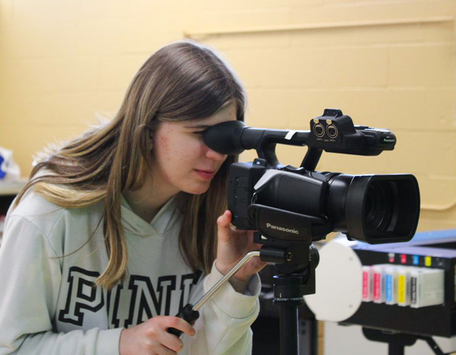
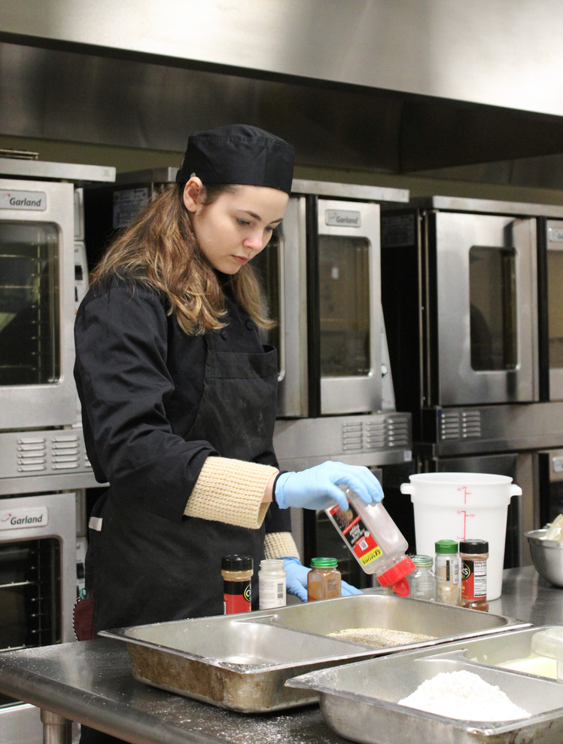
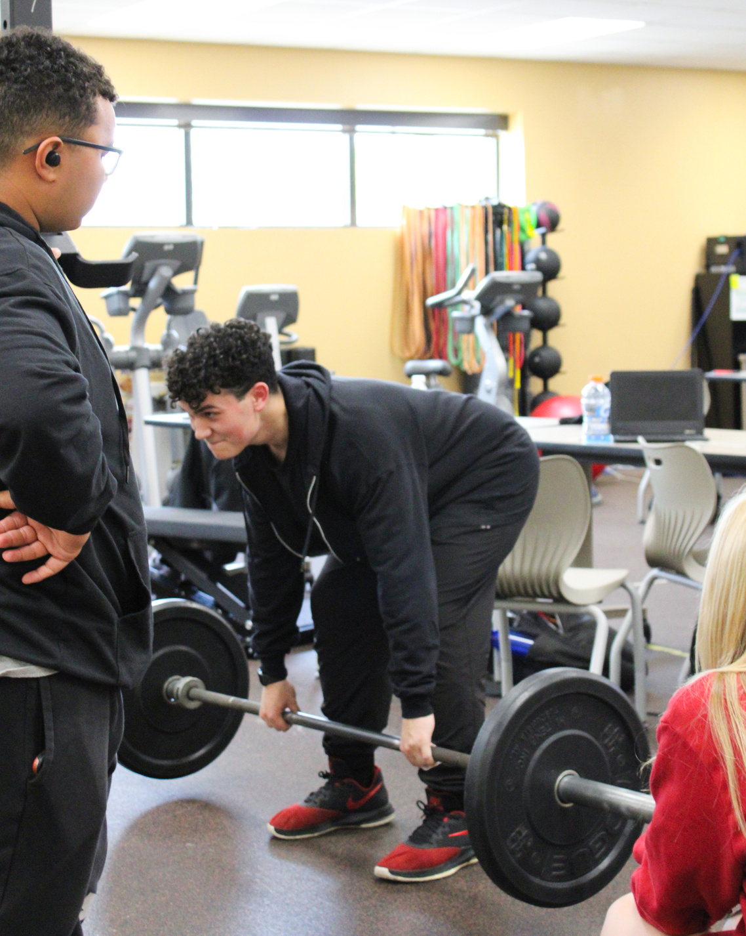
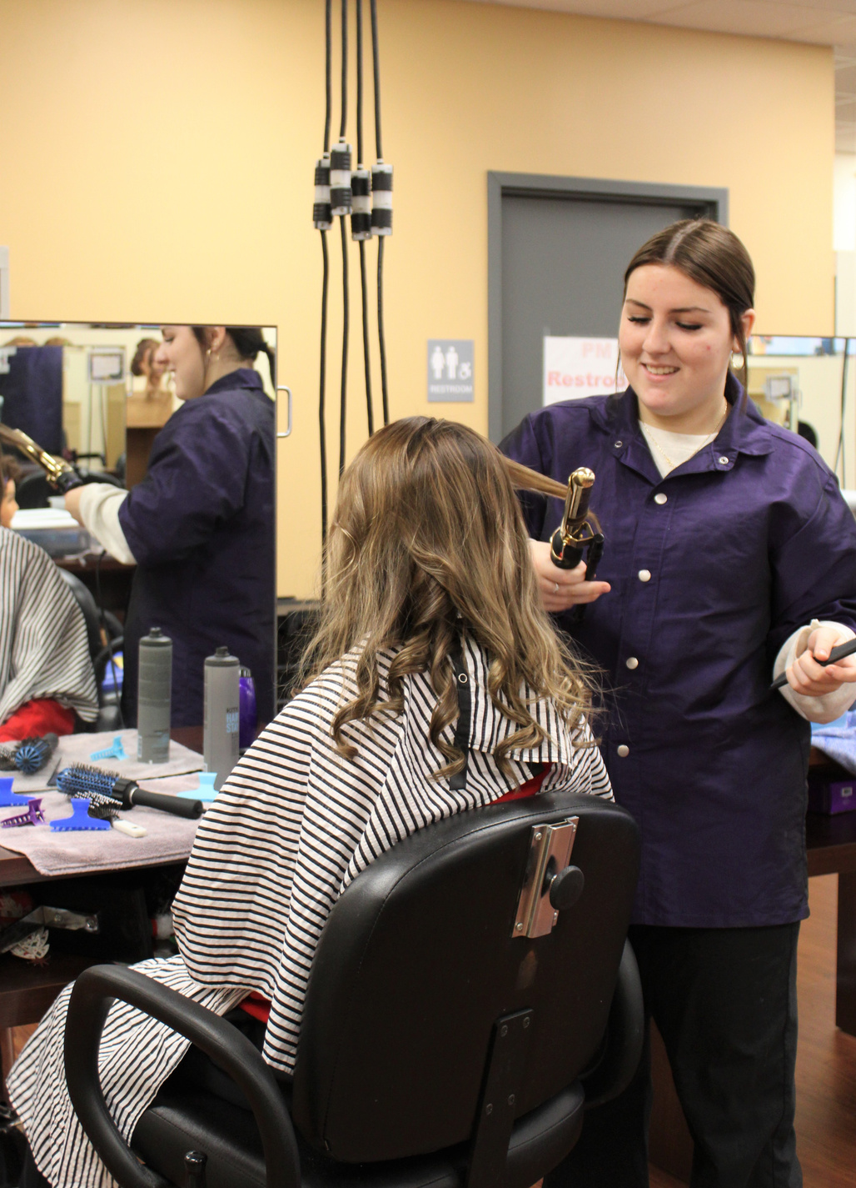
WORK-BASED LEARNING
Our goal is for all students to obtain 54 hours of work-based learning throughout their program
Work-Based Learning includes:
Shadowing
Internships
Paid Co-op
Unpaid Co-op
Field trips
Guest speakers
Live work/school-based enterprise

Slide 9
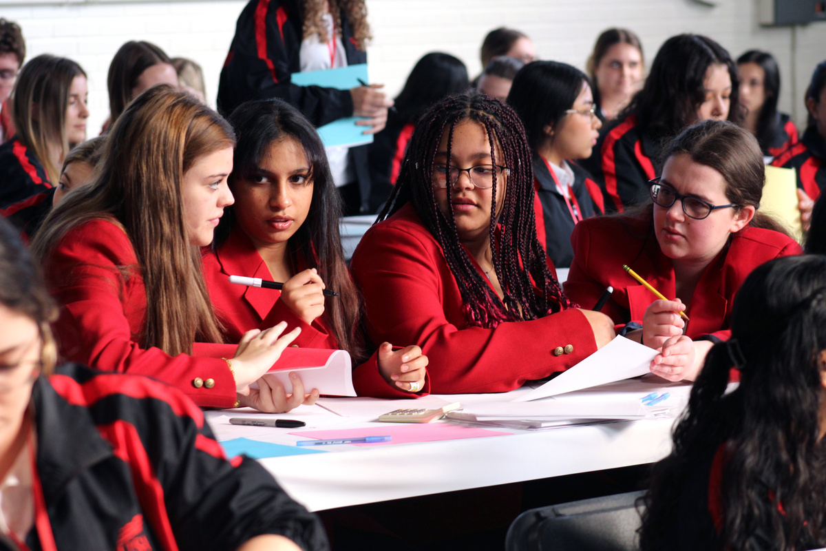

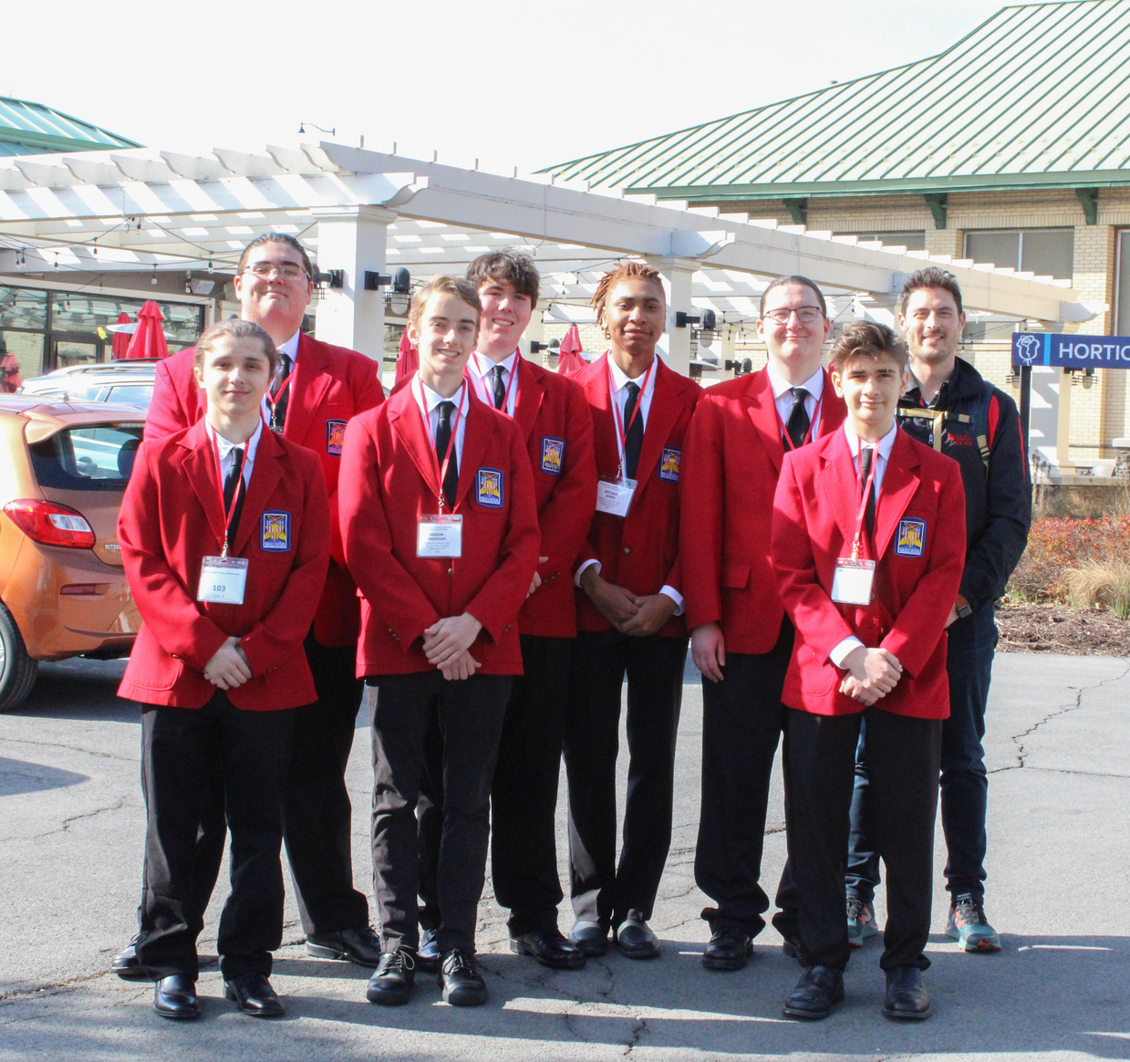
CAREER AND TECHNICAL STUDENT ORGANIZATIONS
SkillsUSA
  Leadership opportunities (chapter officers, state officers
  Competitions (Local, Regional, State and National levels)
  Community service projects
  Member-only events/meetings
  SkillsUSA Framework (Personal Skills, Workplace Skills, Technical Skills grounded in academics)

Slide 10
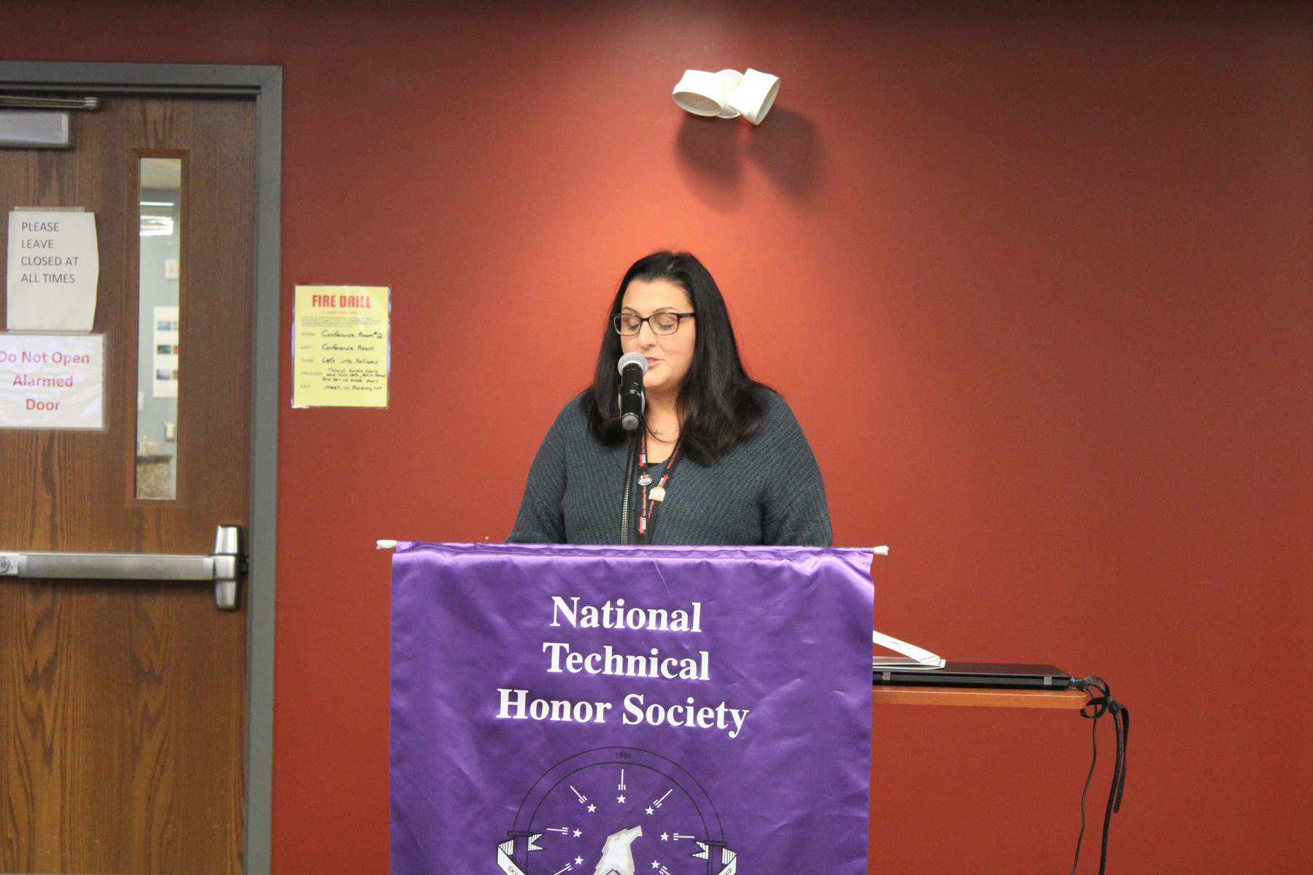
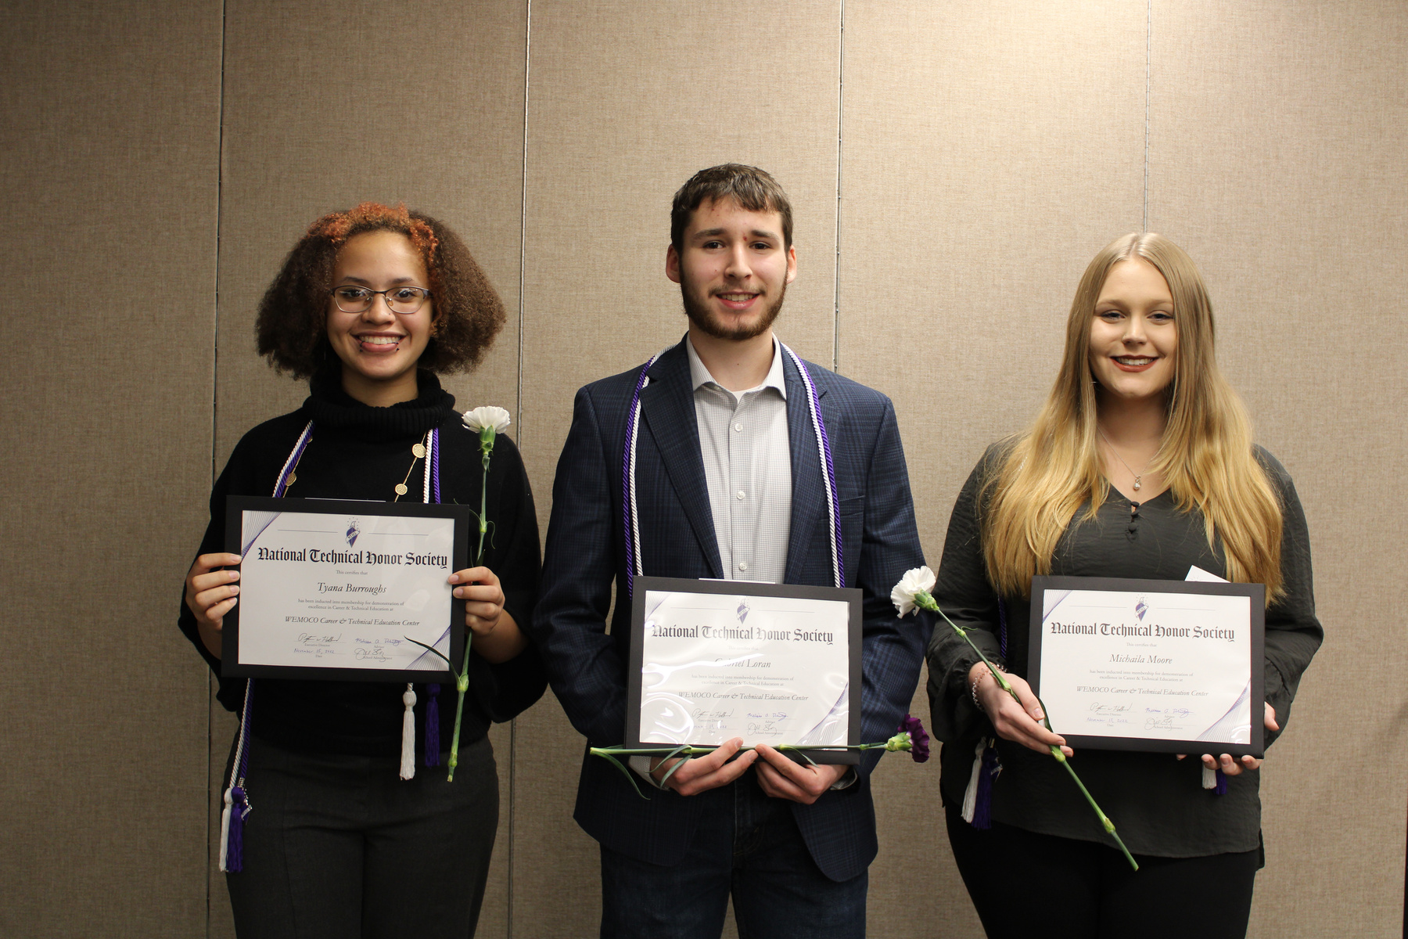
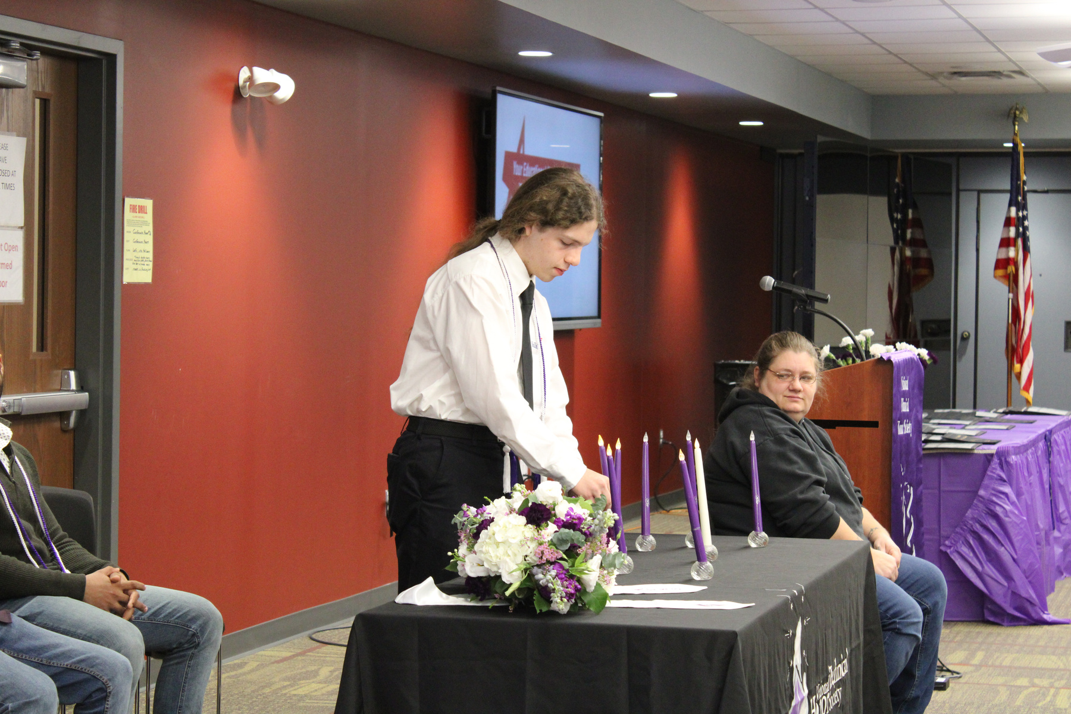
CAREER AND TECHNICAL STUDENT ORGANIZATIONS
National Technical Honors Society
  Leadership opportunities
  Scholarship opportunities
  Community service projects
***Students who meet criteria and complete application process are inducted their senior year

Slide 11
CAREER AND TECHNICAL STUDENT ORGANIZATIONS
Future Farmers of America
  The premier youth organization preparing members for leadership and careers in the Science, Business and Technology of agriculture.

Slide 12
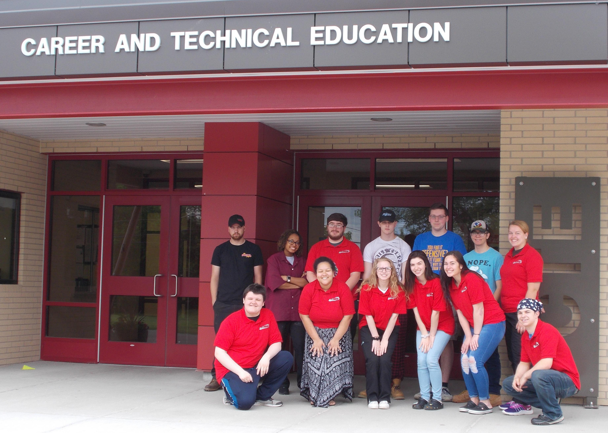
STUDENT AMBASSADORS
A leadership opportunity for students to represent and promote WEMOCO to prospective students and people throughout the community
Provide tours
Greet and direct visitors
Assist with other roles at WEMOCO events

Slide 13
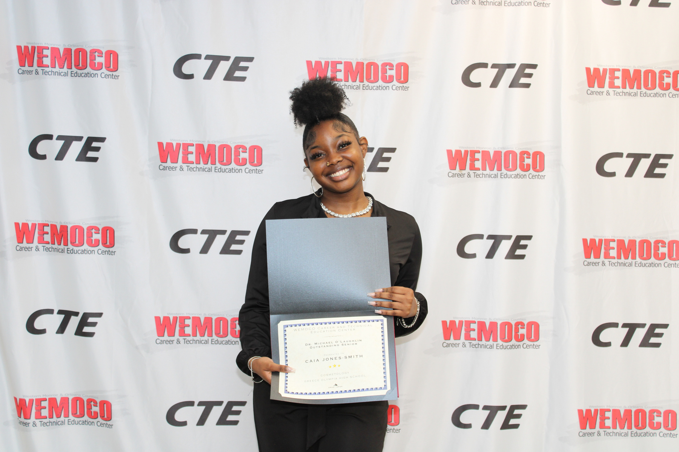
SCHOLARSHIPS
Monroe2boces.org/Scholarships
Local scholarships
BOCES 2 specific
CTE specific scholarships
Career and Technical Student Organization related scholarships

Slide 14
RESOURCES
CTE Parent Portal | Monroe2boces.org/CTEParentPortal.aspx
CTE Website | Monroe2boces.org/CTE
Advanced CTE Website | Careertech.org

Slide 15

CTE ADMINISTRATION
Tony Britt
Theresa Alampi-Cortez
David Thering
Assistant Principal
(585) 352-2480
Tbritt@monroe2boces.org
Assistant Principal
(585) 352-2675
Tcortez@monroe2boces.org
Assistant Principal
(585) 352-2717
Dthering@monroe2boces.org

