Slide 1



Data Security and Privacy
Notes:
Notes
The Regional Information Center Data Security and Privacy Project is designed to inform the educational community about issues and best practices related to protecting student, teacher and principal data.

Slide 2
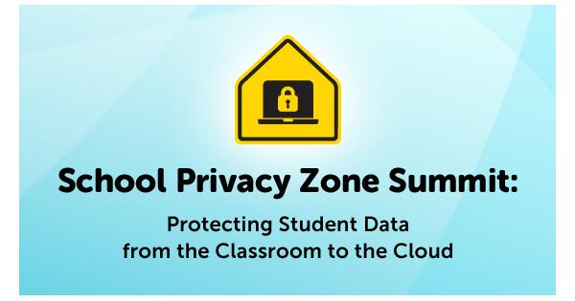
February 24, 2014
Featuring:
Keynote Speaker: Arne Duncan
with FTC Commissioner: Julie Brill
Introducing:
Privacy Technical Assistance Center
Notes:
Common Sense Media

Slide 3
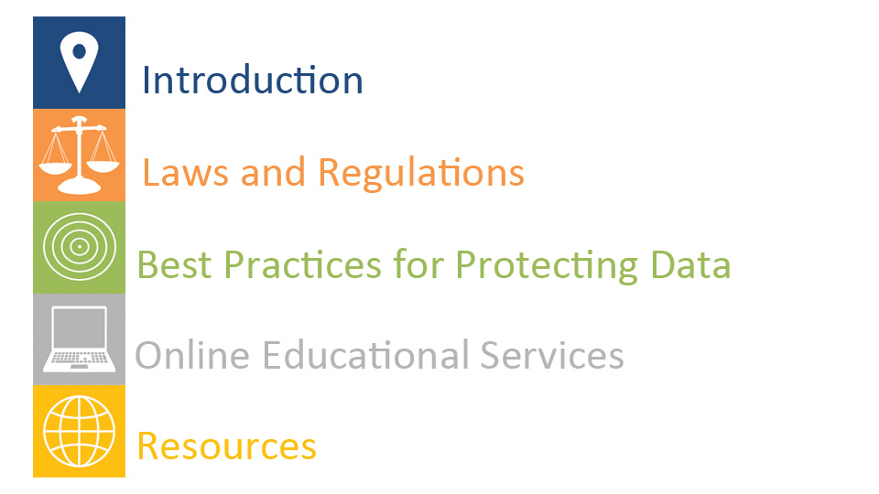
Notes:
Notes
There are five sections to the presentation, summarized as follows:
Introduction: Context on data security and privacy issues in K-12 education, introduces NYS education law 2-d, and discusses privacy challenges and concerns.
Laws and Regulations: Key provisions of federal laws concerning data security and privacy, NYS Education Law 2-d, and the Student Privacy Pledge.
Best Practices for Protecting Data: Guidance on secure management of data.
Online Educational Services: Best practices for reviewing terms of service agreements and contracts with online education service providers.
Resources: Websites that districts can visit for valuable resources on data security and privacy including guidance, training, checklists and more.

Slide 4

This is Data
Notes:
Data is an Android – a big walking computer
Data is also Sentient Being – he is conscience, self aware, think, feel and create

Slide 5
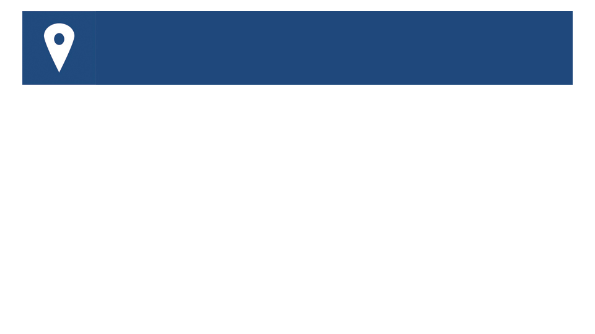
Defining Security and Privacy
Data Security
What we do to protect data
Data Privacy
What we do to protect individuals
Notes:
Notes
Security and Privacy are critical in K-12 education as the use of data systems, including online providers, continues to increase.
Security and Privacy are not the same.
There are various (and more technical definitions), but this is a quick and easy way to think about security versus privacy.
Additional Information
Other Definitions:
Data Privacy deals with the ability an organization or individual has to determine what data in a computer system can be shared with third parties.
Data Security deals with preventing unauthorized access to computers, databases, and websites

Slide 6
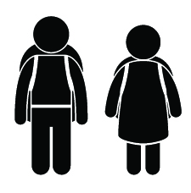
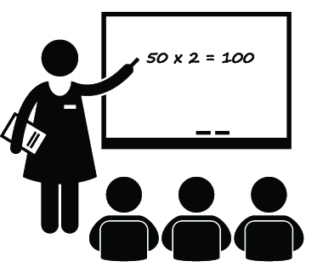
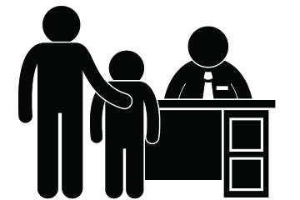
Whose privacy must we protect?
STUDENTS
TEACHERS
PRINCIPALS
NEW
New York State Education Law 2-d
Notes:
Notes
We often hear about issues around “student” data privacy. But schools store much more data, including sensitive data on teachers and principals.
NYS Ed Law 2-d language specifically refers to protecting student , teacher and principal data.
This introduces NYS Ed Law 2-d, but it will be addressed in detail in the Laws and Regulations section.

Slide 7
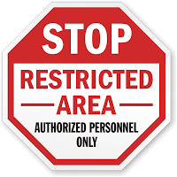

What data must we protect?
Demographics
Enrollment
Attendance
Discipline
Disability
Free and Reduced Lunch
English Language Learner
Individual Education Programs
Local Assessment Scores
NYS Assessment Scores
Course Grades
Career and Technical Education
Graduation and Diploma
Human Resources
Annual Professional Performance Review
Student Learning Objectives
…and more
Notes:
Notes
The slide shows a sample of the many types of data school district’s store as part of their every day business.
The large number of data and systems help illustrate the scope of security and privacy issues.
A complete list of NYS Student Information Repository System data elements can be found at http://www.p12.nysed.gov/irs/sirs/ and at nysdsp.org
Why do we collect all this data? School Operations, Measuring Progress of Students, Improving the Education Program and Meeting the needs of students (surveys and other feedback).
Data includes information from student educational records, as well as data that is involved in the APPR process for teachers and principals
Think about the vast amounts of data that originations manage and to which individuals have access, and the importance of security and privacy.

Slide 8
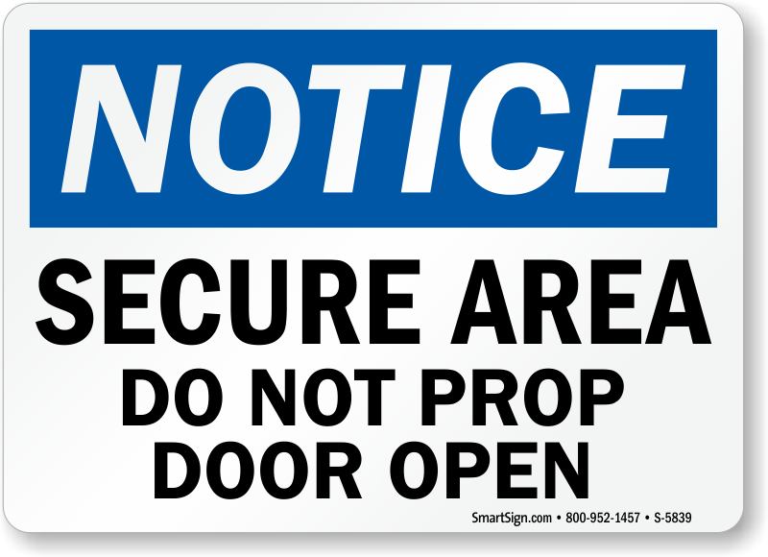
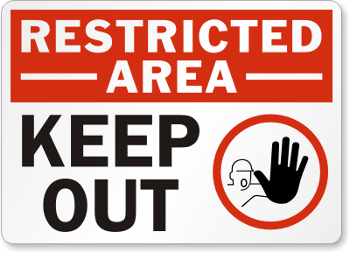
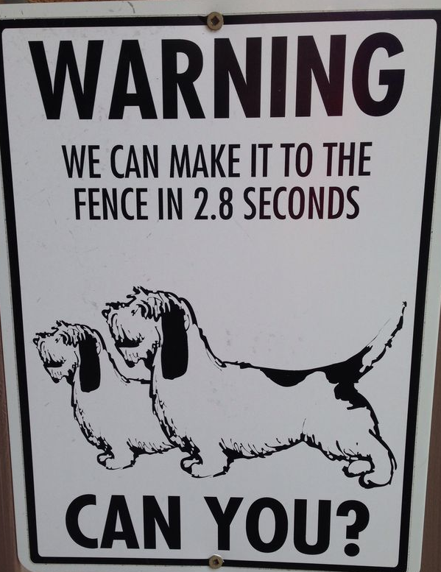
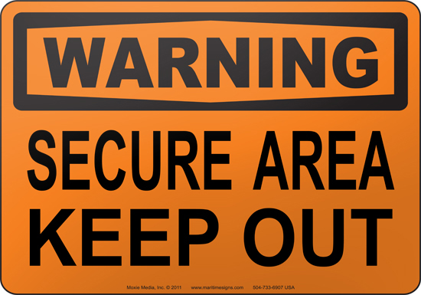
Schools manage data in multiple systems
Student Information
Special Education
Human Resources
Cafeteria Management
Transportation
Learning Management
Online Services and Mobile Apps
  …and many more
Notes:
Notes
All of this data is stored across many different vendor data systems and district databases.
Later we will discuss best practices for individuals and organizations for protecting this data.
Systems used by districts can number in the dozens. More systems include:
Assessment
Content Management System
Credit Recovery
Curriculum Mapping
Guidance
Financial
Instructional
Medical
Messaging
Network Management
Parent-Teacher Scheduler
Physical Education/Athletics
Productivity
Professional Development
School Board Communications
Security
Student Data Analysis
Substitute Teacher
Teacher Evaluation
Telephone

Slide 9
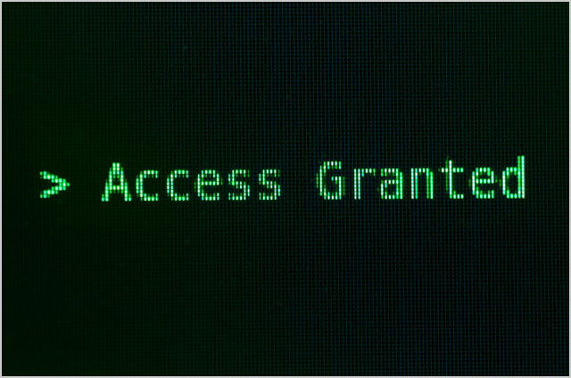
What are the challenges?
The more we rely on technology, the more privacy is threatened
New technology = new threats
Laws lag technology
Data is very valuable
Privacy is PERSONAL
Adapted from Bob Moore, RJM Strategies LLC
Notes:
Notes
New Technologies: Many people have smart phones with video cameras, GPS with them at all times.
Many laws were written a long time ago. Some updates have occurred and more are proposed.
Data is Valuable: .Search data can be saved, sold and used for advertising

Slide 10
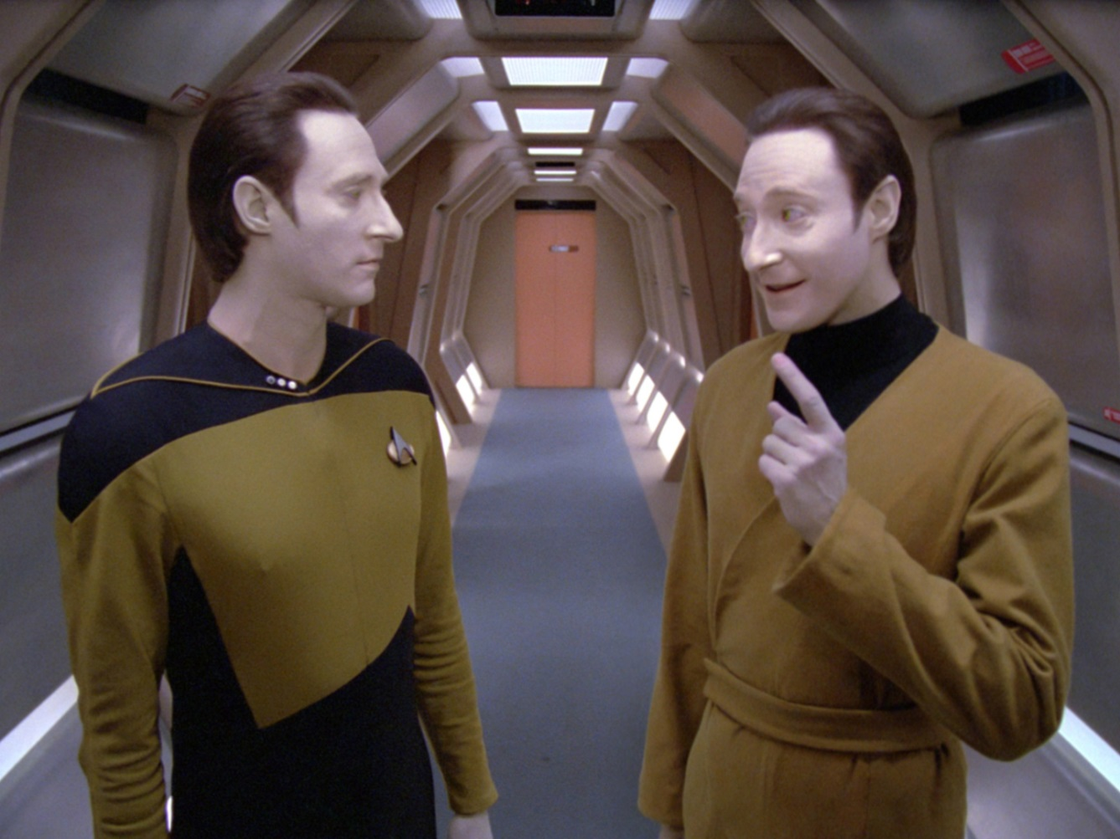
What are the concerns?
Commercial use of data
Need to Know access to data
Digital footprints
Security breaches
Adapted from Bob Moore, RJM Strategies LLC
Notes:
Notes
Need to Know refers to the fact that only those who need data to perform job functions should have access. Account management issues are addressed in the Best Practices for Protecting Data section.
Digital Footprints (Unintended Consequences)
Unintentionally “Over-Sharing”
Failing to Understand or Apply Social Media Privacy Settings
Trusting Others to Treat Data About You with Respect
Digital Content Lives Forever (Whether You Want It to or Not!)
Think about breadcrumbs left around the web….facebook, searches, posts, etc that are no longer under your control…

Slide 11
U.S. Secretary of Education on Privacy
From School Privacy Zone Summit (2014):
Schools need data to do business, but with a commitment to privacy.
Data should be used only for educational purposes.
School systems and technology providers need policies on handling data.
Priorities and communication are key.
Federal laws include FERPA, PPRA, COPPA.
State and local laws may apply.
The field of security and privacy is developing rapidly.
Notes:
Notes
USDOE Secretary Arne Duncan has spoken on the importance of protecting data. The video will let us hear it in his words, but this slide summarizes the main points.
Show edited excerpt of Arne Duncan Speech, located on the RIC Data Security and Privacy website.
Our state law is NYS Education Law 2-d
Additional Information
The excerpt is from edited from:
http://www.youtube.com/watch?v=kRR-HndqoYY
The full text is at:
http://www.ed.gov/news/speeches/technology-education-privacy-and-progress

Slide 12
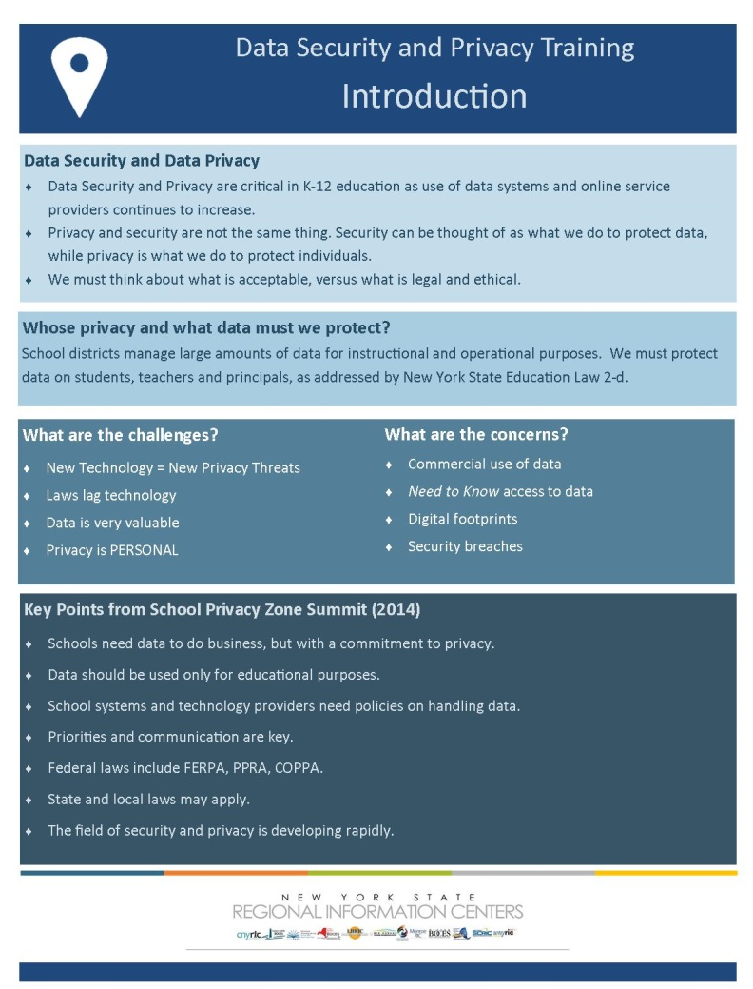
Introduction
Key Ideas
Notes:
Notes
Summarize the section and refer to the Key Ideas handout.

