Slide 1

Online Educational Services

Slide 2

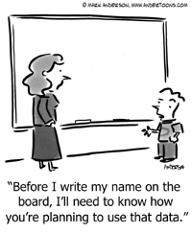
Section Overview
Contracts
Click-Wrap Agreements
Best Practices

Slide 3

Online Educational Services - Issues
Districts commonly contract out school functions and utilize online services.
Traditional contracts involve a mutually agreed upon set of terms and a signed document between the parties.
Many online services and mobile apps use a Terms of Service (TOS) agreement that only requires a user to click a button to accept (Click-Wrap Agreements)
Notes:
Notes
Teachers often use sites that use click-wraps and are not sanctioned by the district.

Slide 4

Contracts
Contracts should be evaluated for the following provisions:
Security and data stewardship
Data collection
Data use, retention, disclosure, and destruction
Data access
Modification, duration, and termination
Indemnification and warranty
Notes:
Notes
See DOE Protecting Student Privacy While Using Online Educational Services : An Overview of Recent Department of Education Guidance documents on DSP website

Slide 5

Click Wrap Agreements
Terms of Service Agreements should be evaluated for items including:
Definition of data, its use, and protections
Marketing and Advertising
Modification of Terms of Service
Destruction of Data
Security Controls

Slide 6
Click Wrap Agreements
Also…
Check amendment provisions
Print (or save) the Terms of Service
Specify authority to accept the Terms of Service
Adapted from Protecting Student Privacy While using Online Educational Services: An Overview of Recent Department of Education Guidance - USDOE/PTAC

Slide 7
Other Best Practices
Districts should…
Establish policies and procedures to evaluate and approve proposed services
Be transparent with parents and students
Consider whether parental consent is appropriate
Evaluate the use of services on a case-by-case basis to determine if the requirements of FERPA and other laws are met
Adapted from Protecting Student Privacy While using Online Educational Services: An Overview of Recent Department of Education Guidance - USDOE/PTAC

Slide 8

Online Educational Services - Documents
Review Key Documents:
Protecting Student Privacy While Using Online Educational Services: Requirements and Best Practices
Security Questions to Ask of An Online Service Provider
Protecting Student Privacy While Using Online Educational Services: Model Terms of Service
Notes:
Notes
The documents are available on the RIC Data Security and Privacy Website. They are from PTAC and COSN (See Resources section).
The presenter may wish to provide copies of these handouts in a live session and discuss further.

Slide 9

ToyTalk Scenario
ToyTalk is an award-winning family entertainment company pioneering the art of conversation with characters. ToyTalk's groundbreaking PullString platform powers the unique creative process that ToyTalk and the world’s leading family entertainment companies use to create conversation with their beloved characters.
The Winston Show is an iPad app in which kids and characters have real conversations in a new dimension of make-believe..
https://www.toytalk.com/editors-picks/

Slide 10
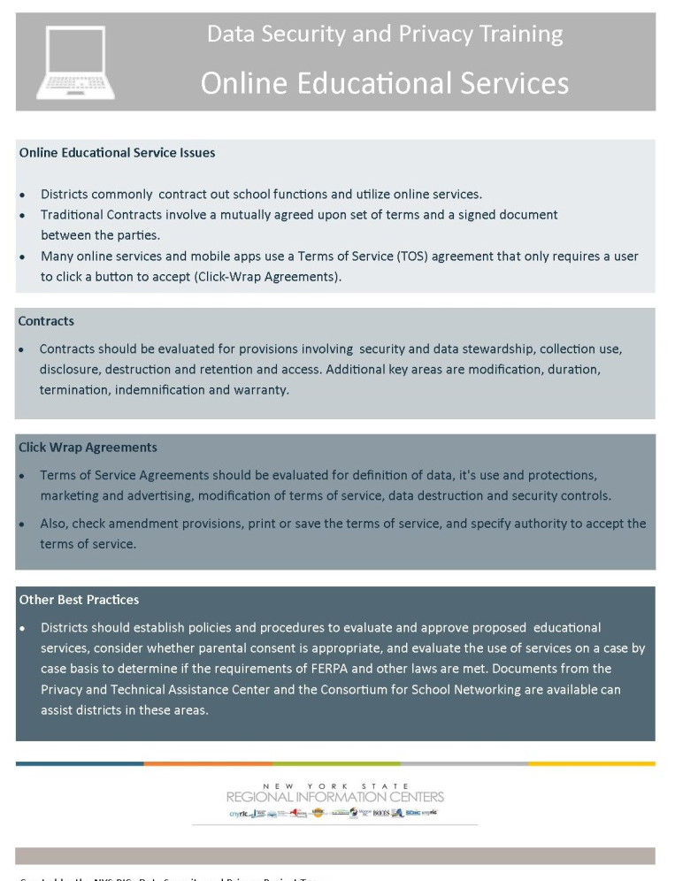
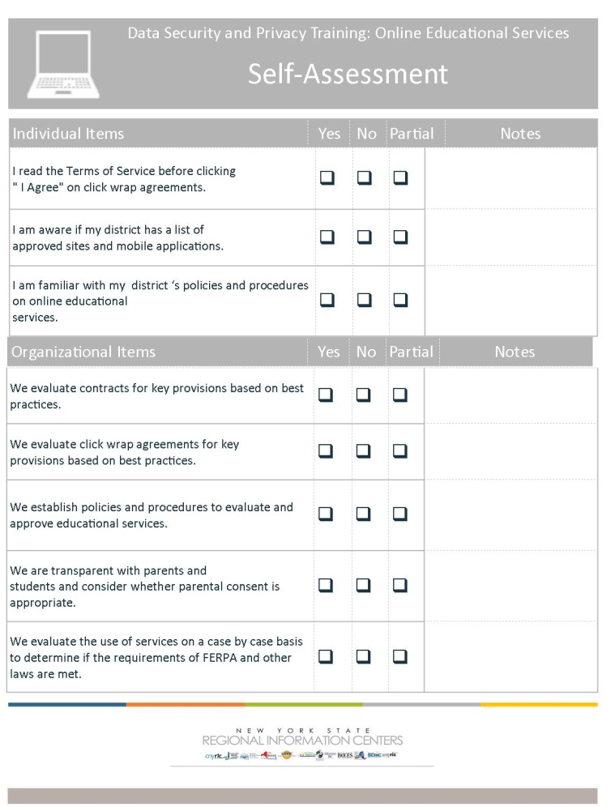
Online Educational Services
Key Ideas
Self-Assessment
Notes:
Notes
Summarize the section and refer to the Key Ideas handout.
Use Self Assessments can be utilized in sessions, or as takeaways at the discretion of the presenter.

